Slide 1
Deep Learning: Advanced topics Optimization Dynamics in Deep Learning ——Over-Parameterization
沈剑豪
信息科学技术学院
jhshen@pku.edu.cn

Slide 2
Outline
Over-parameterization helps optimization
Implicit acceleration
Convergence rate w.r.t. depth and width
Lottery ticket hypothesis
Background
Optimize over structure
Pruning is all you need

Slide 3
Overparameterization
Deep neural networks are usually overparameterized
Num of params >> Num of samples
Expressiveness √
Generalization ?
NN can fit both structured data and random data
Optimization ?
Gradient explode / vanish

Slide 4
Depth as a Preconditioner
General Consensus:
Depth improves expressiveness, but complicates optimization (gradient explode/vanish)
Batch norm / residual connections
But depth can accelerate optimization
Depth has a similar effect as momentum and adaptive regularization
[Sanjeev et al., 2018]

Slide 5
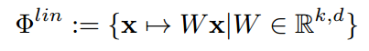
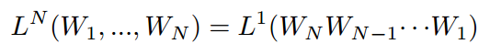
Decouple from expressiveness
Depth improves expressiveness => helps optimization
shallow net cannot attain the same loss as deep net
Linear Neural Networks
Loss function over W

Slide 6
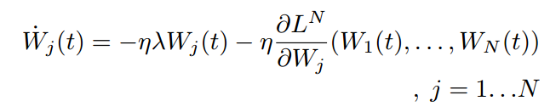
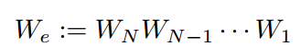
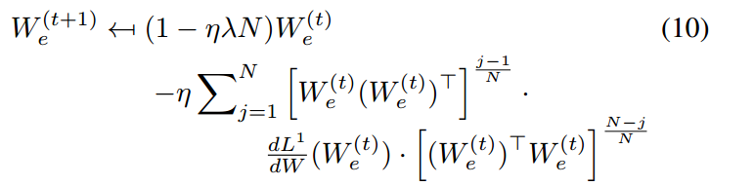
Dynamics of W
Notes:
Lambda-weight decay

Slide 7
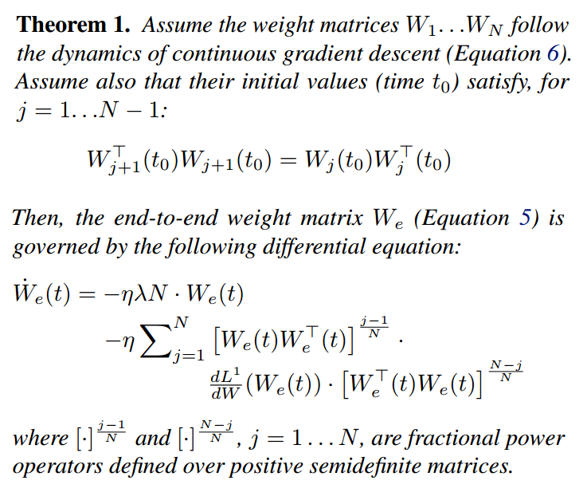
Dynamics of W
Notes:
Lambda-weight decay

Slide 8
Dynamics of W
if initialization values are close enough to zero or identity matrix
=> Small initialization (+ residual connection)
Notes:
Lambda-weight decay

Slide 9
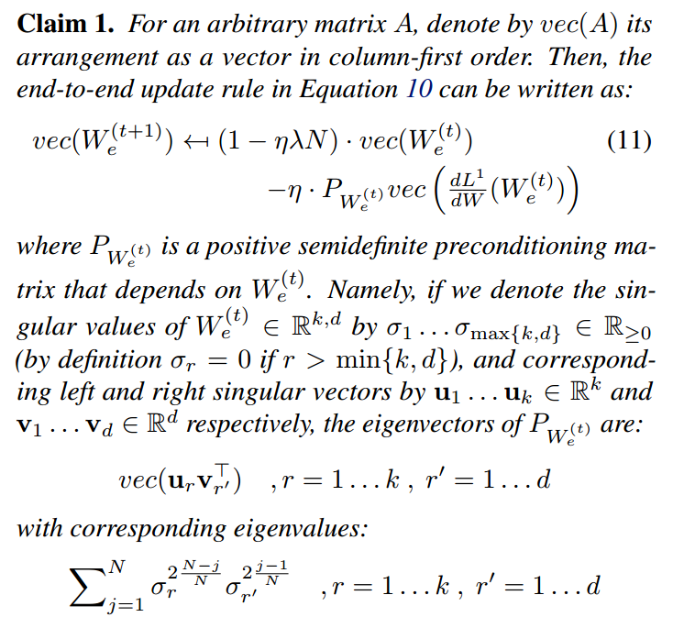
Dynamics of W

Slide 10
Dynamics of W
promoting movement along directions that fall in line with the current location in parameter space
Remark1: if W is initialized near 0, W_{e}^{(t)} is the movement until t
Remark2: the preconditioning doesn’t depend on the width

Slide 11
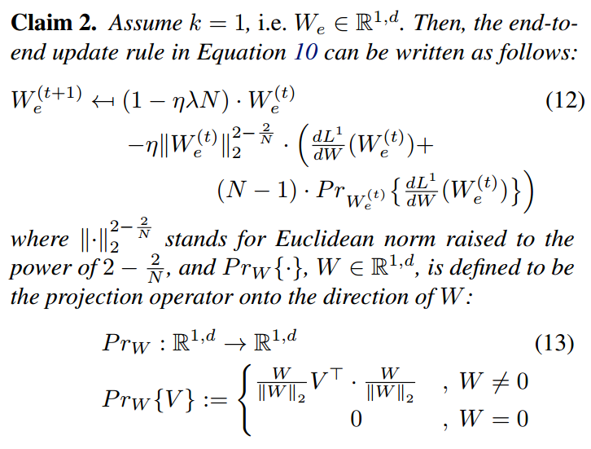
Single output case
adaptive learning rate
amplifies the projection of the gradient on the direction of W_{e}

Slide 12
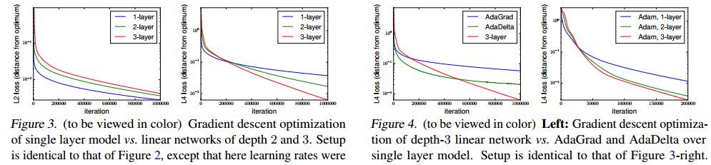
Experiments
initialized to small values, drawn i.i.d. from a Gaussian distribution with mean zero and standard deviation 0.01
Acceleration from depth is compatible to (or better than) AdaGrad/AdaDelta, and some what orthogonal to Adam

Slide 13
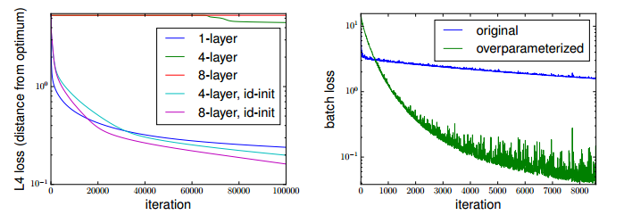
Experiments
For deep NN, identity init is important
CNN, placing two matrices in succession instead of the matrix in each dense layer

Slide 14
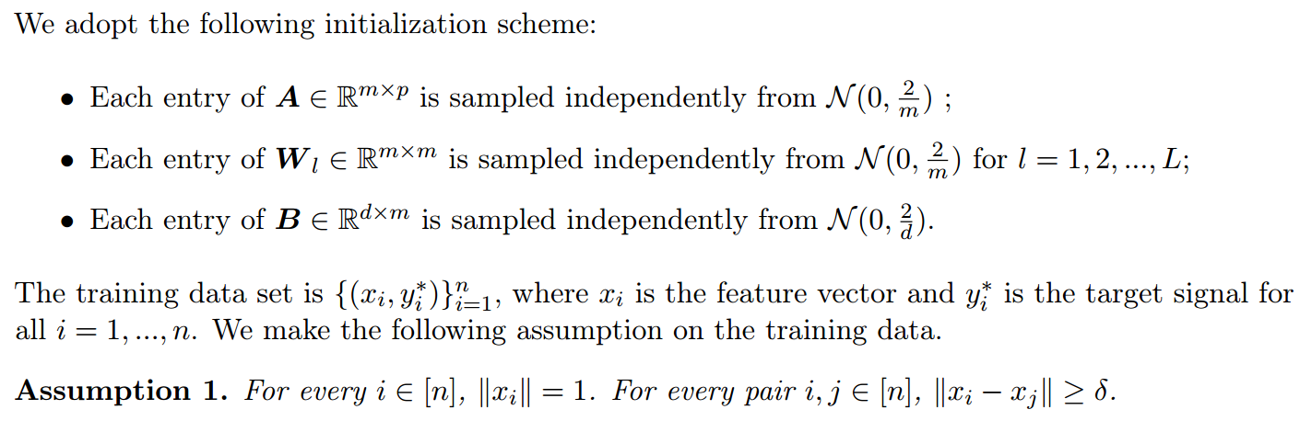
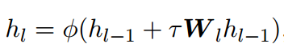
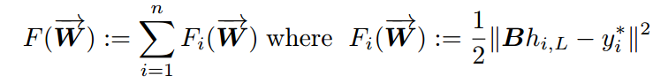
Training deep ResNet is as easy as a two-layer NN
[Huishuai et al., 2019]

Slide 15
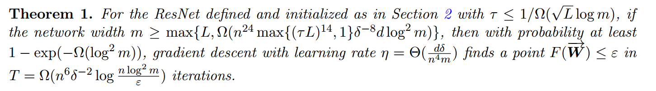
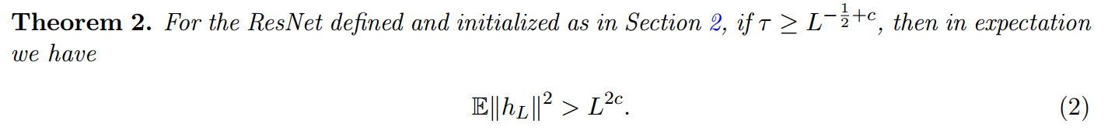
Training deep ResNet is as easy as a two-layer NN
T is almost depth independent
(Thus training deep residual network can be as easy as training a two-layer network)

Slide 16
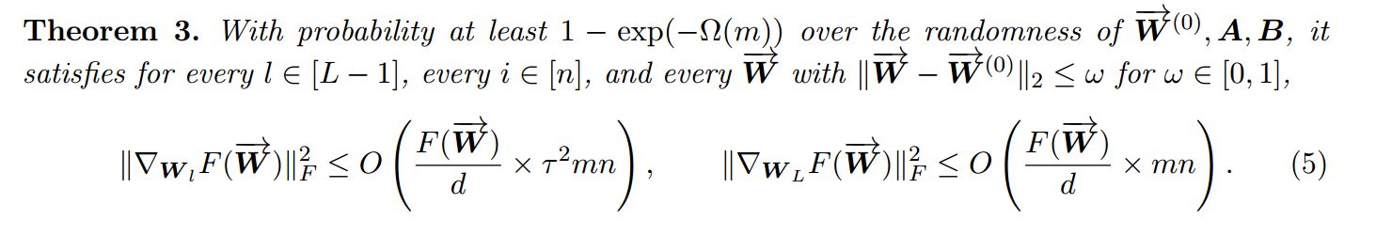
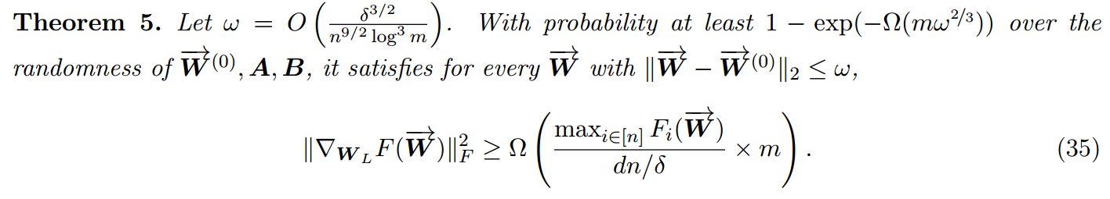
Key Points

Slide 17
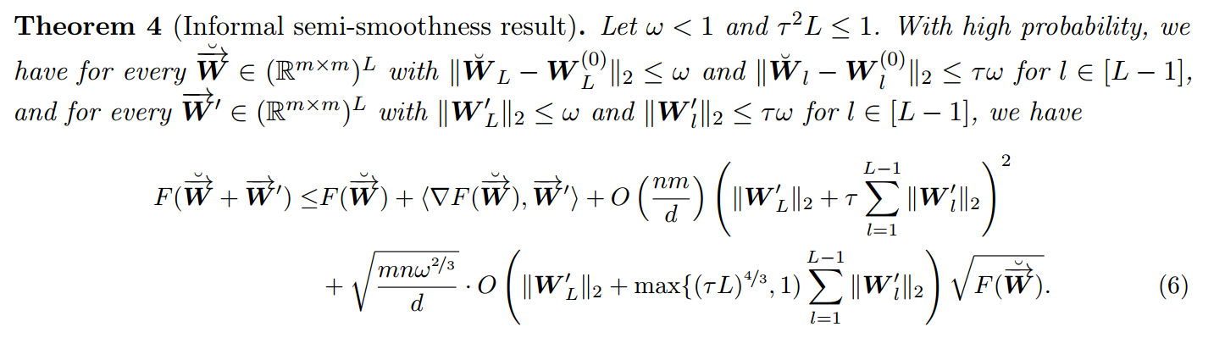
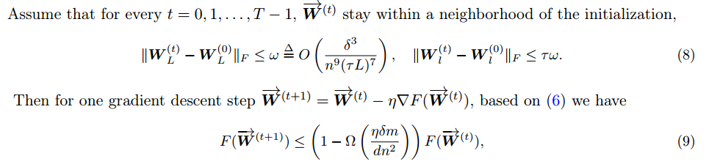
Key Points
Close to the initialization

Slide 18
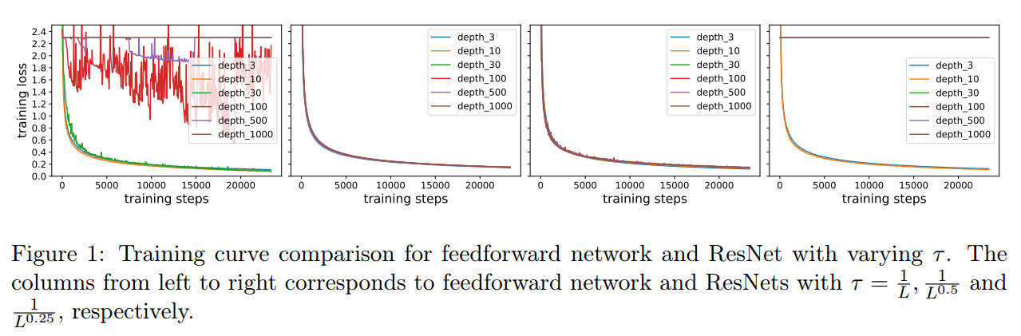
Experiment

Slide 19
Over-Param + SGD on Structured Data
Overparameterized + SGD provably learns a 2-layer NN close to the random initialization and with a small generalization error when the data is well structured
[Yuanzhi and Yingyu, 2018]

Slide 20
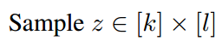
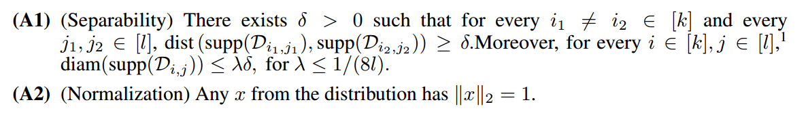
Structured Data
the data in each class is a mixture of several components
Assumptions

Slide 21
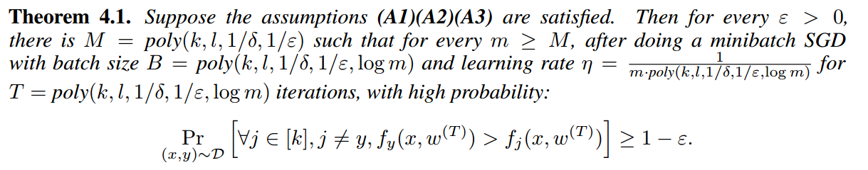
Over-Param + SGD on Structured Data
Remarks
The error is measured on the true distribution
T grows in the speed of poly(log m)

Slide 22
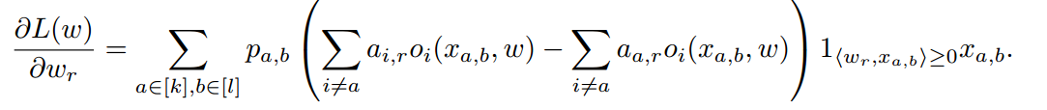
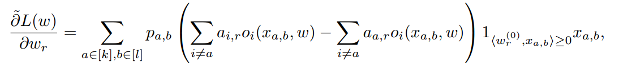
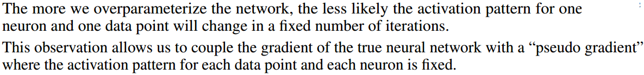
Pseudo Gradient
True gradient:
Pseudo gradient:

Slide 23
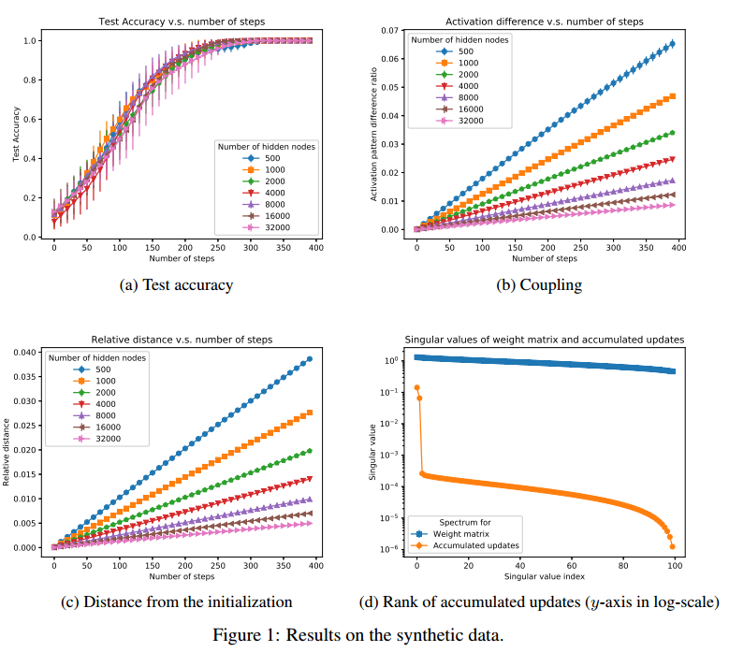
Experiment

Slide 24
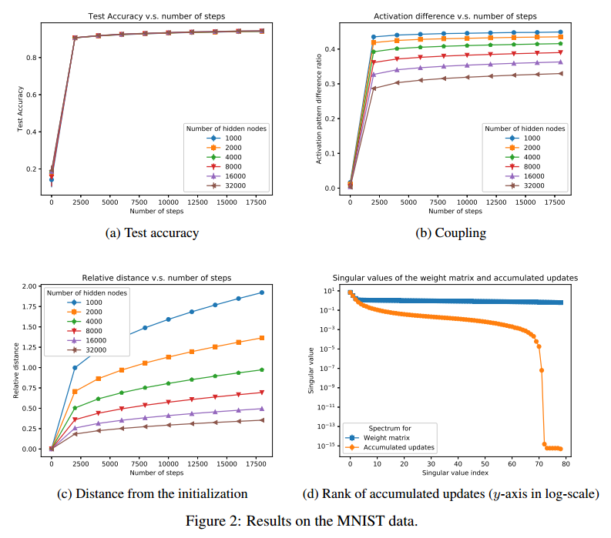
Experiment

Slide 25
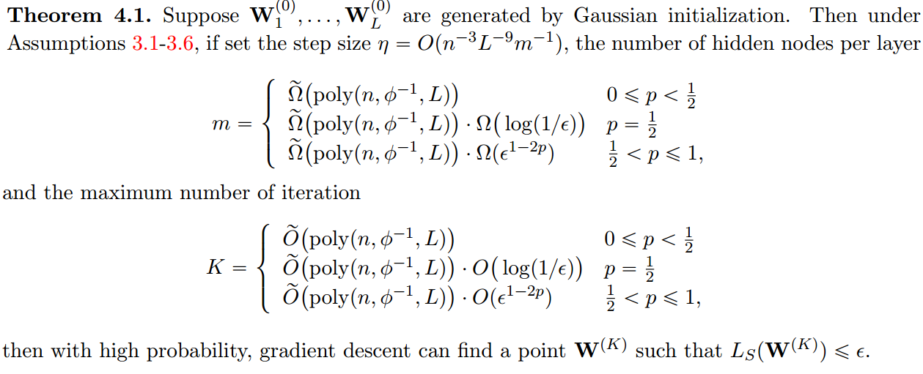
For deep NN
[Difan et al., 2018]

Slide 26
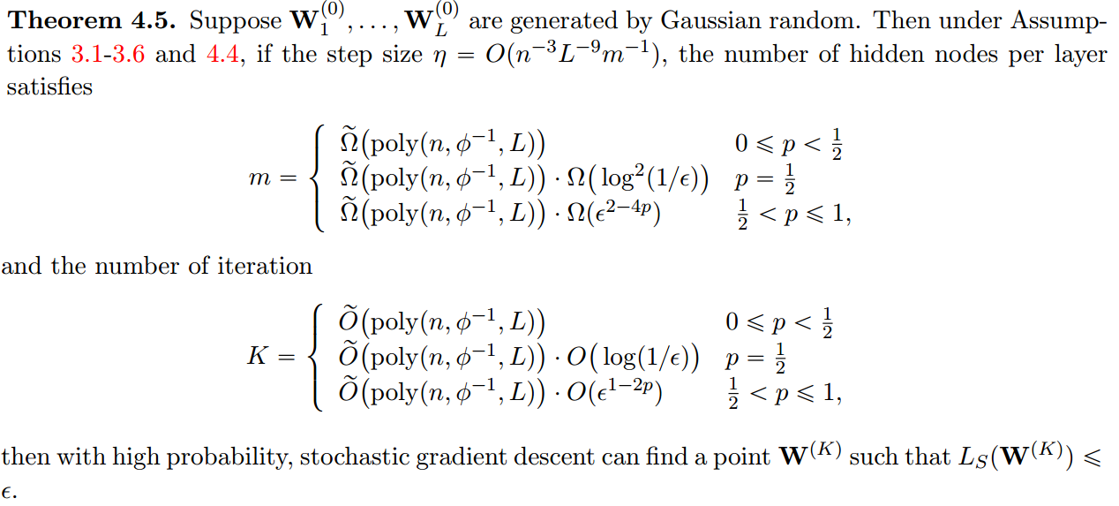
For deep NN

Slide 27
Lottery Ticket Hypothesis
Network Pruning
Prune more than 90% params without harming accuracy
But train the small one from scratch is hard
[Jonathan et al, 2018]

Slide 28
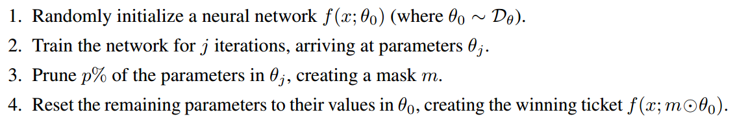
Identifying lottery tickets
One shot pruning
Iterative pruning
Train, prune, reset over n rounds

Slide 29
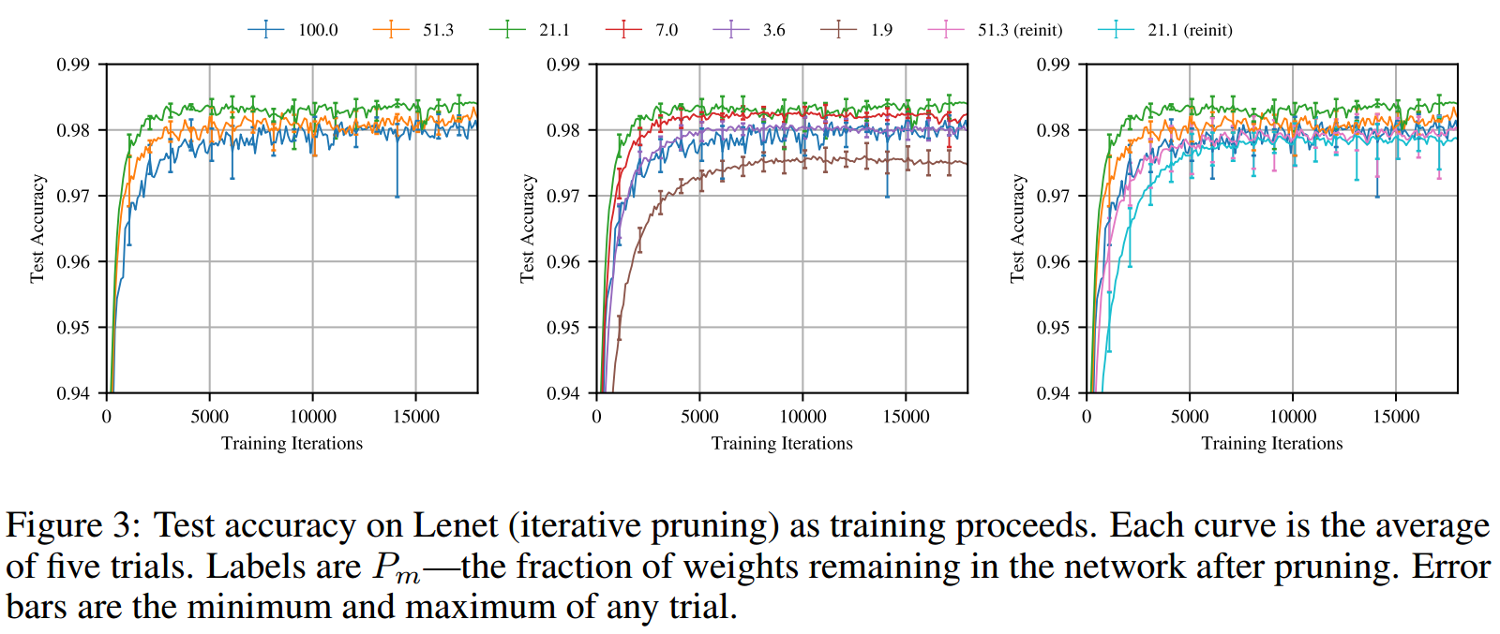
Lottery Tickets

Slide 30
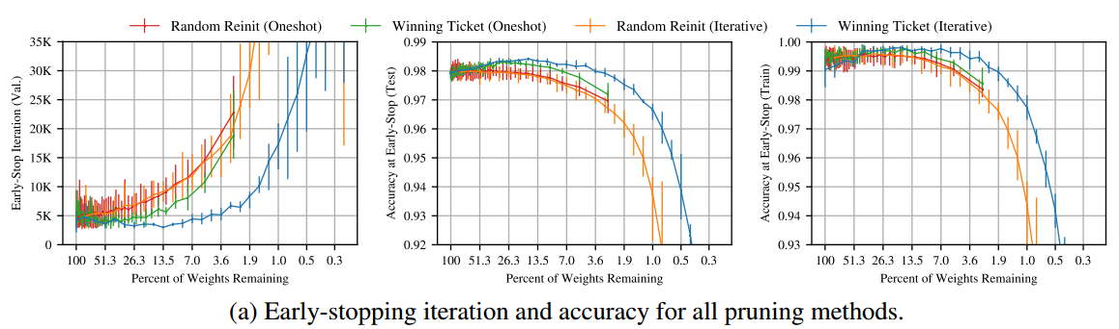
Lottery Tickets

Slide 31
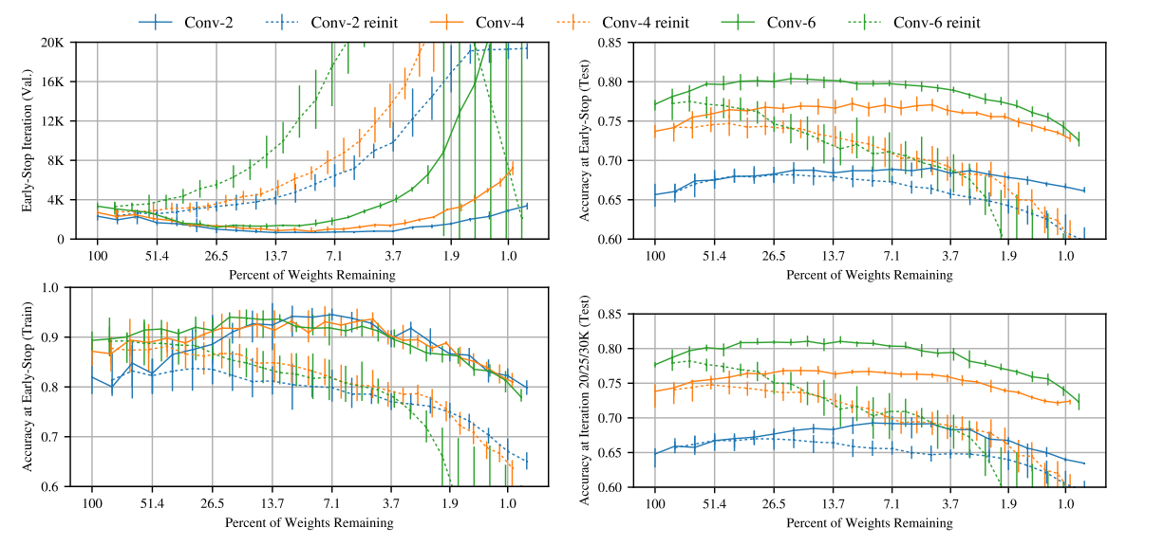
LT in CNN
Overparameterized networks are easier to train because they have more combinations of subnetworks that are potential winning tickets

Slide 32
Further Analysis of LT
Mask criteria
Mask-1 actions
Mask-0 actions
[Hattie et al., 2019]

Slide 33
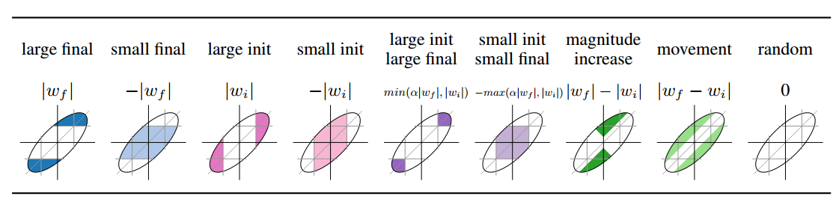
Mask Criteria

Slide 34
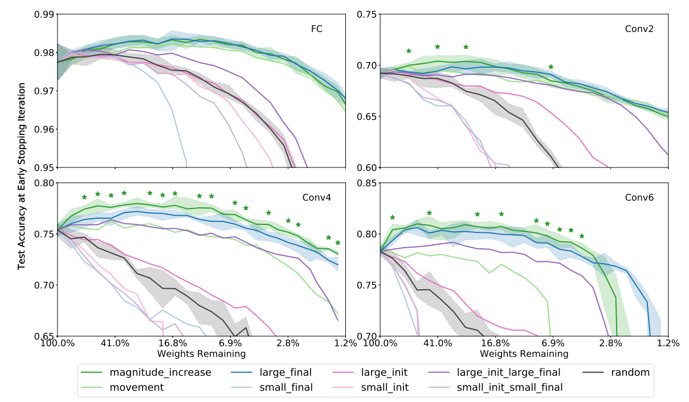
Mask Criteria
Magnitude_increase can match or exceed large_final

Slide 35
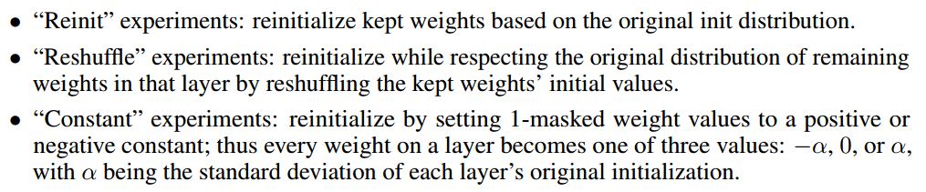
Mask-1 actions

Slide 36
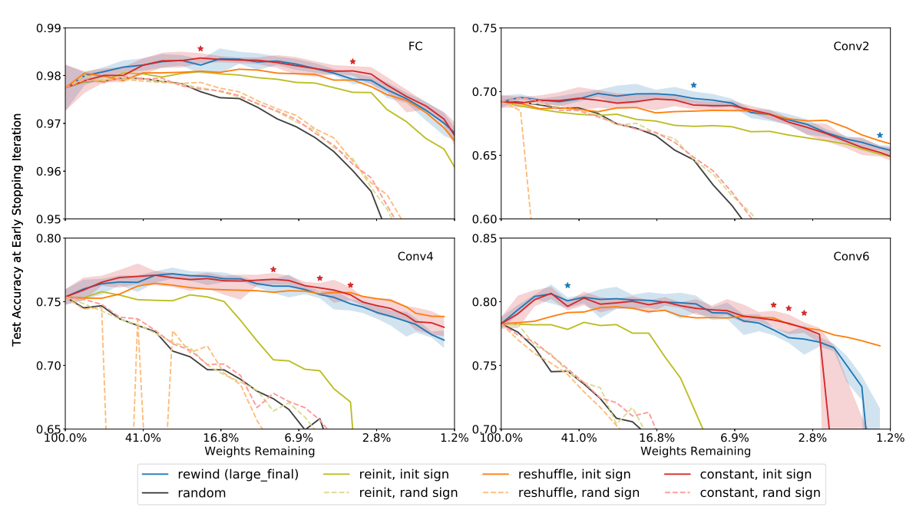
Mask-1 Actions
It is the sign that matters!

Slide 37
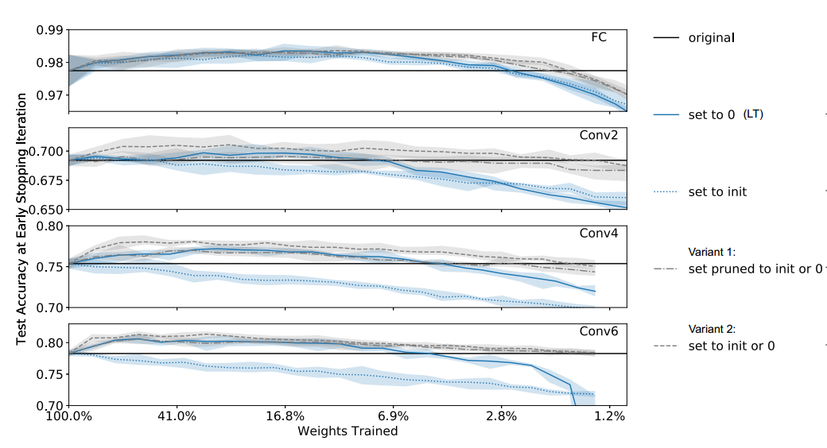
Mask-0 Actions
Masking is training!
“masking operation tends to move weights in the direction they would have moved during training”

Slide 38
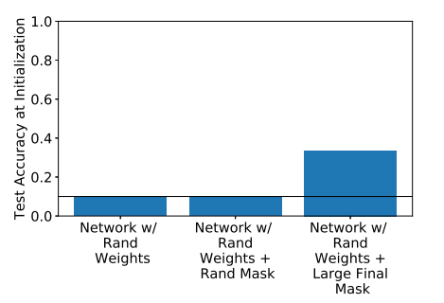
Supermasks
With a well-chosen mask, an untrained network can already attain a test accuracy far better than chance

Slide 39
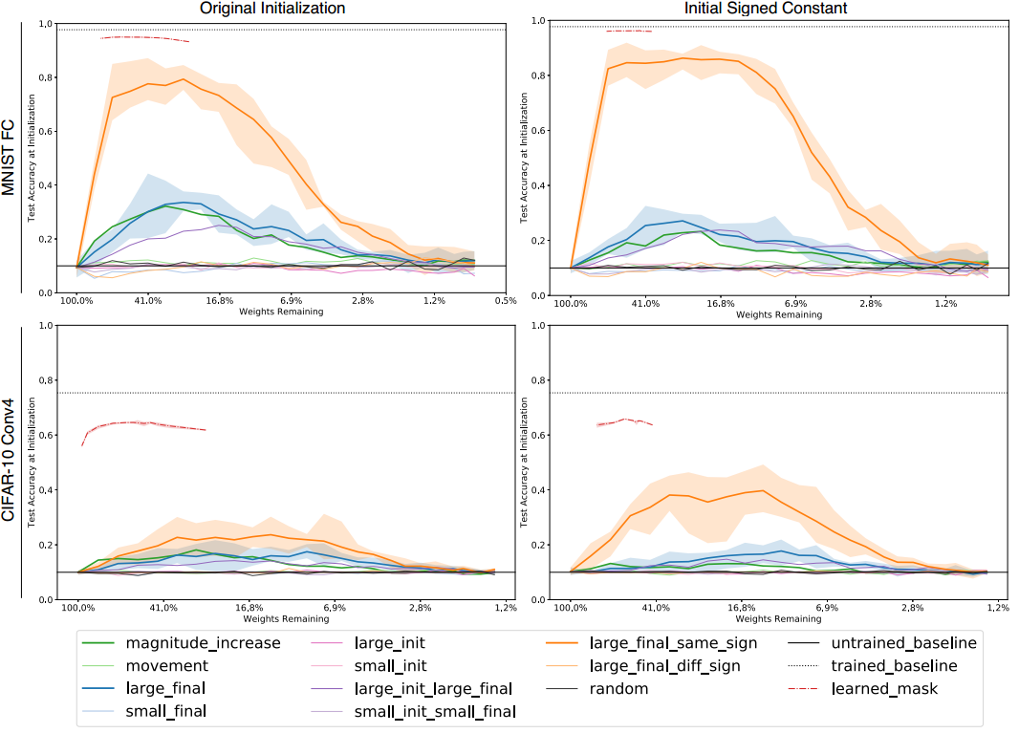
opt weight
->opt structure

Slide 40
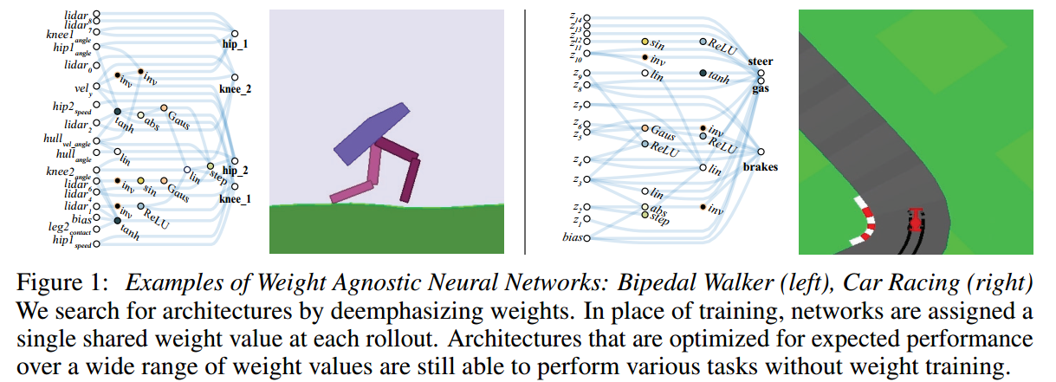
Weight Agnostic Neural Networks
[Yuanzhi and Yingyu., 2018]

Slide 41
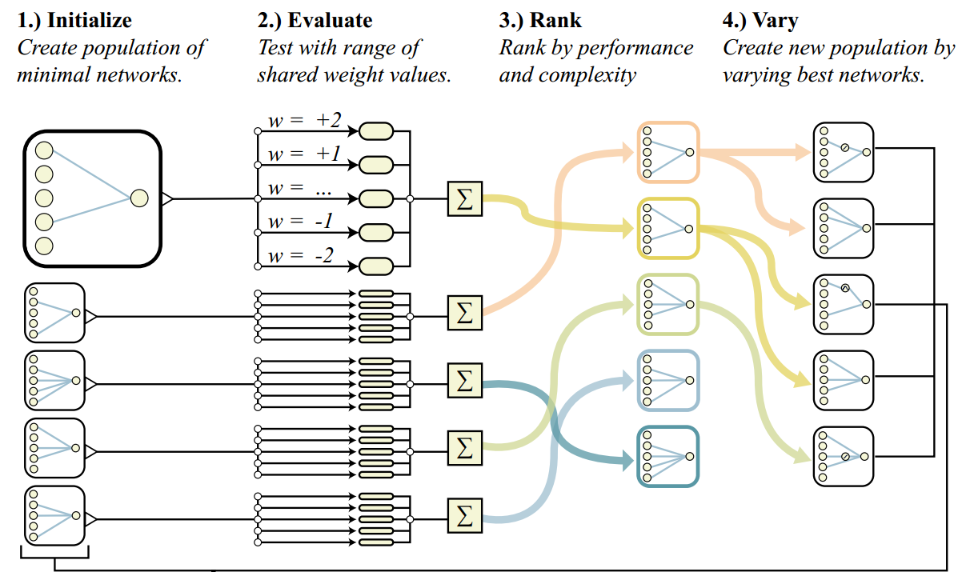

Slide 42
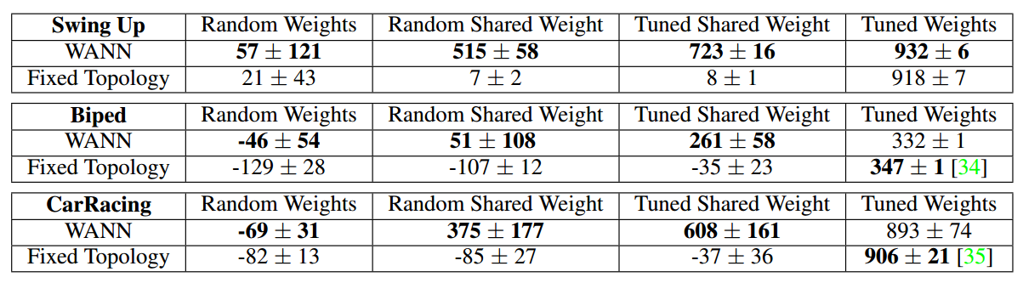
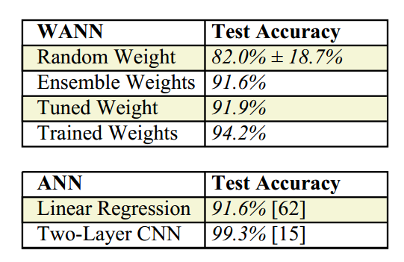
Results
opt weight -> opt structure

Slide 43
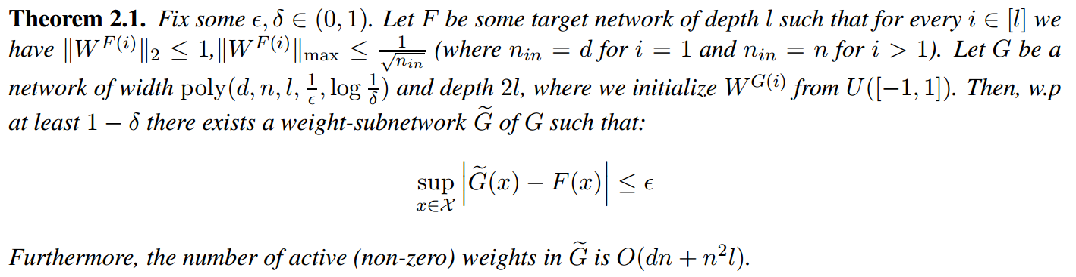
Pruning is All You Need
A sufficiently over-parameterized neural network with random initialization contains a subnetwork that achieves competitive accuracy (with respect to the large trained network), without any training
[Eran et al., 2020]

Slide 44
Summary
Overparameterization helps optimization
Depth as a preconditioner
Optimization path stays close to the random initialization
Lottery ticket hypothesis
Overparameterized network contains LT
Optimization over structure
(SGD finds LT?)

Slide 45
Reference:
[Sanjeev et al., 2018] Sanjeev A., Nadav C., and Elad H. On the Optimization of Deep Networks: Implicit Acceleration by Overparameterization
[Huishuai et al., 2019] Huishuai Z., Da Y., Mingyang Y., Wei C., and Tie-yan L. Convergence Theory of Learning Over-parameterized ResNet: A Full Characterization
[Yuanzhi and Yingyu, 2018] Yuanzhi L. and Yingyu L. Learning Overparameterized Neural Networks via Stochastic Gradient Descent on Structured Data
[Difan et al., 2018] Difan Z., Yuan C., Dongruo Z., and Quanquan G. Stochastic Gradient Descent Optimizes Over-parameterized Deep ReLU Networks

Slide 46
Reference:
[Jonathan et al, 2018] Jonathan F., and Michael C. THE LOTTERY TICKET HYPOTHESIS: FINDING SPARSE, TRAINABLE NEURAL NETWORKS
[Hattie et al., 2019] Hattie Z., Janice L., Rosanme L., and Jason Y. Deconstructing Lottery Tickets: Zeros, Signs, and the Supermask
[Adam and David, 2019]Adam G., and David H. Weight Agnostic Neural Networks
[Eran et al., 2020] Eran M., Gilad Y., Shai S., and Ohad S. Proving the Lottery Ticket Hypothesis: Pruning is All You Need

